Slide 1



ADAPTIVE AUTOMATIC HEADLIGHT INTENSITY CONTROLLER FOR VEHICLES
By CCE-23003
CCE-23004

Slide 2

PROBLEM STATEMENT
  Night driving becomes hazardous due to glare from oncoming vehicle headlights.
  Glare can temporarily blind drivers and increase the risk of accidents.
  Manual headlight adjustment is inconvenient and distracts the driver.
  Existing adaptive systems are expensive and complex, used mainly in luxury vehicles.
  There is a need for a low-cost, automatic, and IoT-enabled system that adjusts headlight brightness intelligently to improve safety and comfort during night driving.
01

Slide 3
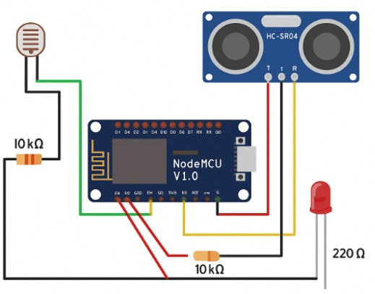
SYSTEM OVERVIEW / WORKING PRINCIPLE
  ESP8266 NodeMCU acts as the main controller.
  LDR Sensor detects ambient light intensity.
  Ultrasonic Sensor (HC-SR04) measures distance from approaching vehicles.
  LED (Headlight Prototype) brightness controlled via PWM.
  Brightness increases in darkness and decreases when another vehicle is nearby.
  System operates automatically without any manual input from the driver.
02

Slide 4
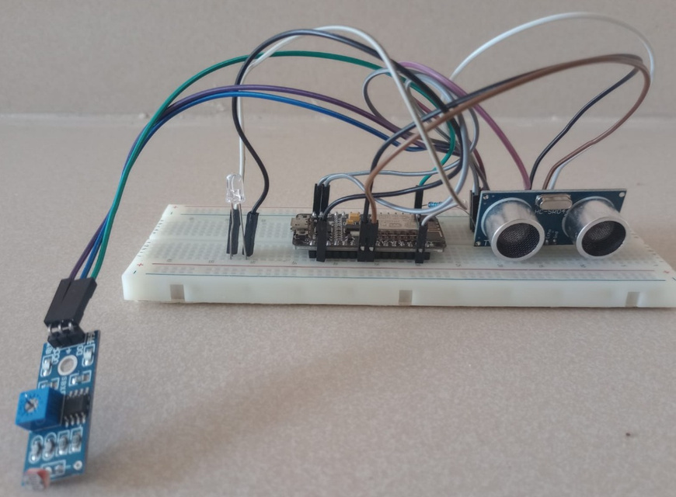
CIRCUIT DESIGN AND IMPLEMENTATION
  Hardware setup includes NodeMCU, LDR, Ultrasonic Sensor, and LED.
  LDR connected to A0, Ultrasonic sensor to D5 (Echo) & D6 (Trigger), LED to D1 (PWM pin).
  Powered via 5V supply or USB connection.
  Prototype assembled on breadboard and successfully tested.
03

Slide 5
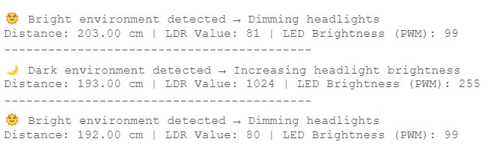
RESULTS AND OBSERVATIONS
  In dark conditions → LDR = 1024, Distance = 200 cm → LED Brightness = 255 (Full Brightness)
  In dark conditions with object nearby → LDR = 1024, Distance = 20 cm → LED Brightness = 127 (Dim)
  In bright conditions → LDR = 80, Distance = 200 cm → LED Brightness = 90 (Dim)
  In bright conditions with object nearby → LDR = 100, Distance = 20 cm → LED Brightness = 50 (Further Dim)
04

Slide 6

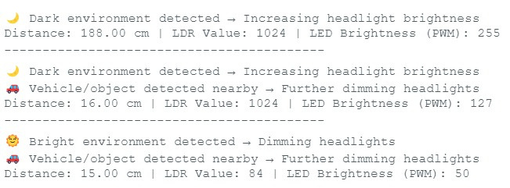
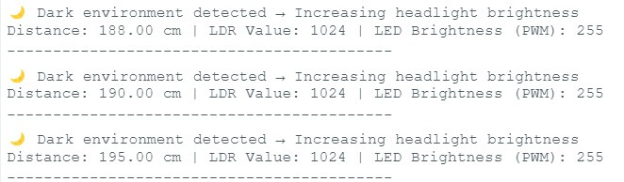
05

Slide 7
ADVANTAGES AND APPLICATIONS
Advantages:
  Prevents glare and enhances driver safety.
  Fully automatic and driver-friendly.
  Energy-efficient and low-cost.
  IoT-ready for remote monitoring and future scalability.
Applications:
  Automotive headlight control systems.
  Smart street lighting.
  IoT-based road safety solutions.
  Adaptive lighting for autonomous vehicles.
06

Slide 8
CONCLUSION
  Successfully implemented an adaptive headlight controller using NodeMCU, LDR, and Ultrasonic sensors.
  Automatically adjusts brightness based on environmental and traffic conditions.
  Improves safety, comfort, and energy efficiency during night driving.
07

Slide 9
FUTURE SCOPE
  Integration with Solar Power.
  Deep Sleep mode for energy optimization.
  IoT cloud connectivity for remote monitoring.
  AI-based glare detection and adaptive learning system.
08

Slide 10
THANK YOU
09

